Slide 1

Early Detection of Pancreatic Cancer: How You Can Make a Difference
Wellness Wednesdays
11/20/2024
Bradford Chong, MD and Christine Drogan, MS, CGC

Slide 2
What is PRECEDE?
International, multi-institutional collaborative group of experts to increase survival for pancreatic cancer patients by improving early detection, screening, risk modeling, and prevention for those with a heritable risk for pancreatic cancer.
Goal: Increase 5-year survival rate from 10% to 50% in within the next 10 years

Slide 3
How is PRECEDE going to reach these goals?
Enrolling 10,000 people with family history of pancreatic cancer
To join, sites must agree to share information with the consortium
Formation of sub-committees to focus on different research areas
Partnerships

Slide 4
Subcommittees
Diversity, Equity and Inclusion
Clinical Genetics
Modifiable Risk Factors
Biomarkers
Imaging
Biostatistics

Slide 5
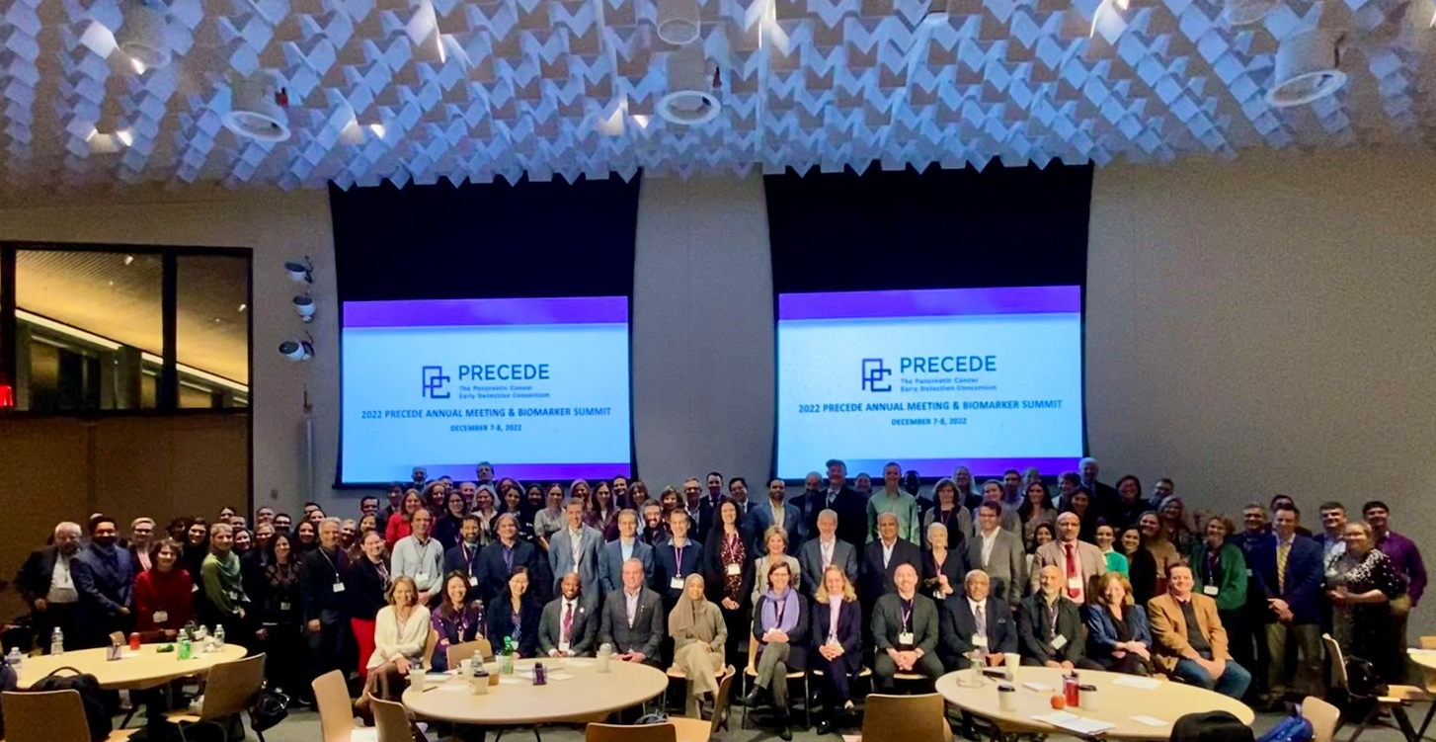

Slide 6
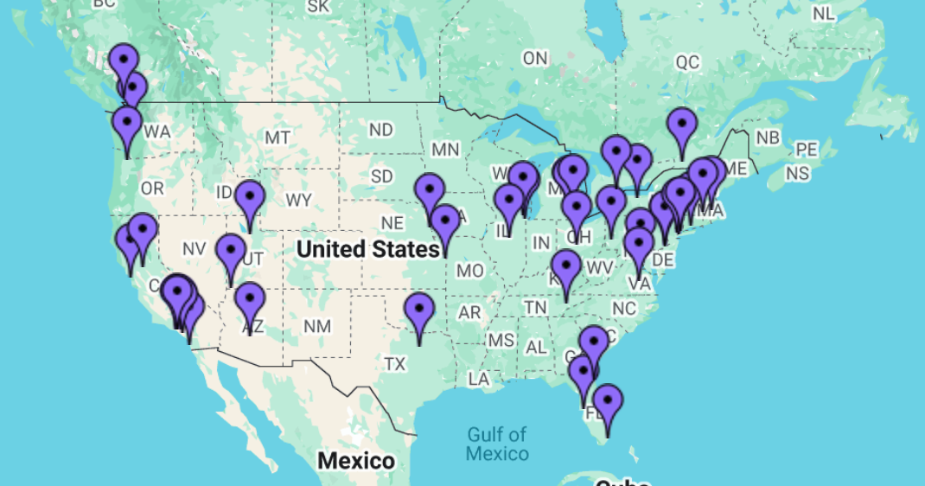

Slide 7
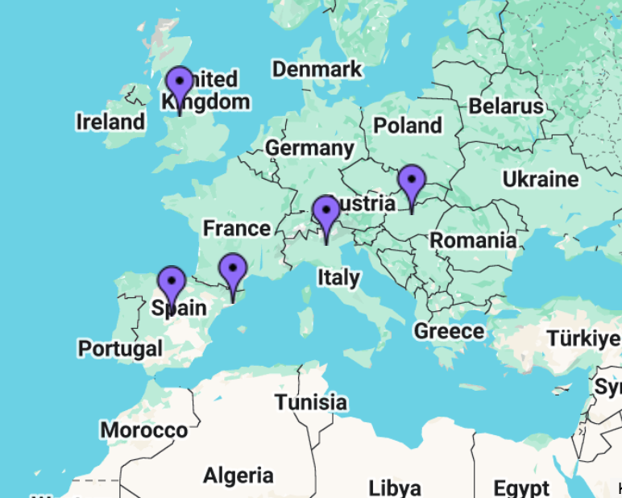
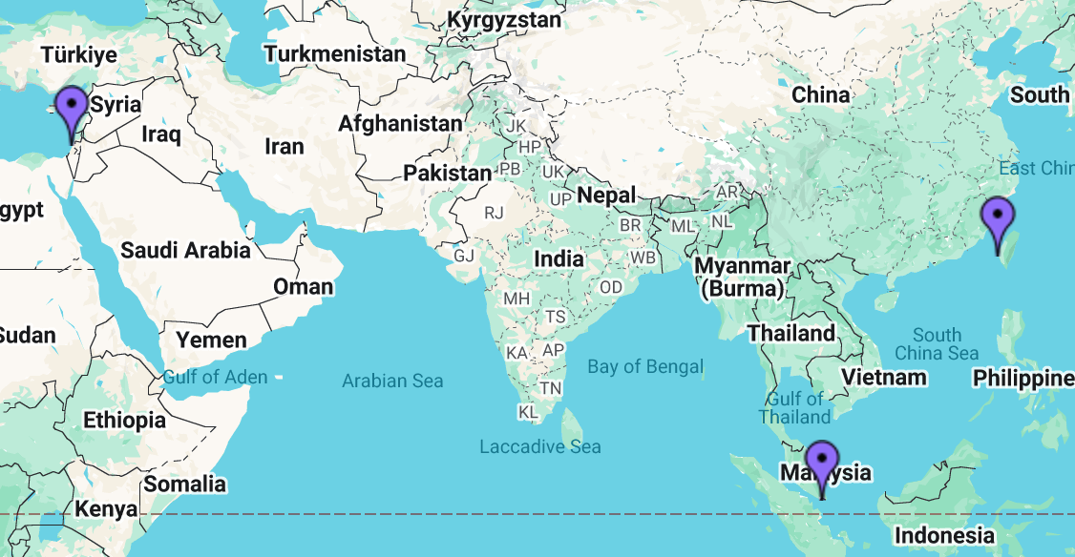

Slide 8
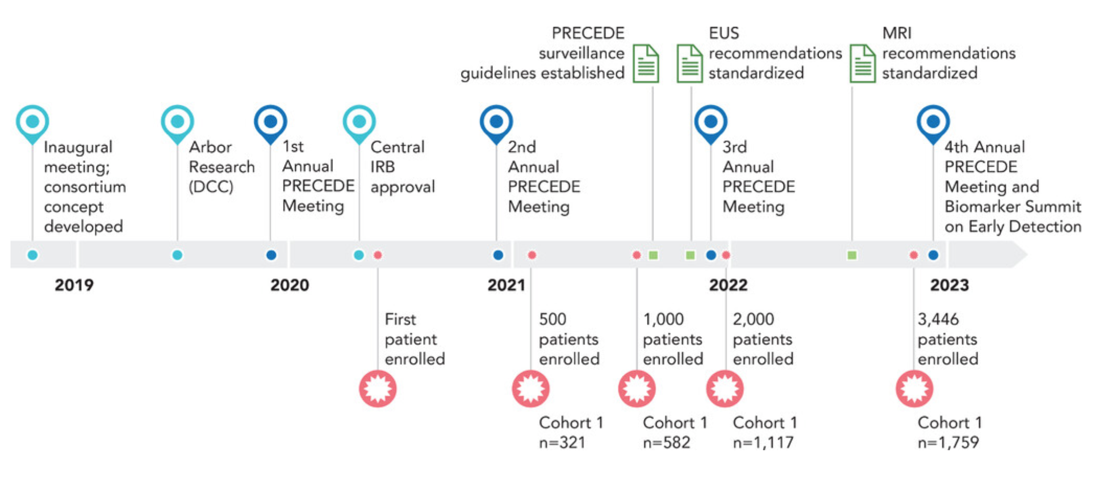

Slide 9
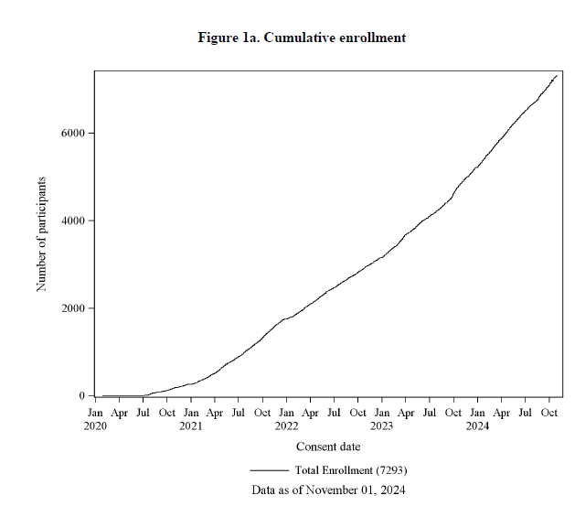
Enrollment
Nearly 200 people per month!

Slide 10
Who can join?
Cohort 1
Family history + mutation or
2+ family members and 50y+
Cohort 2
BRCA/PALB2/ATM+ or
1 close relative w/ PDAC <45 and 50y+
Cohort 3
Meets criteria for Cohort 1 or 2, but are <50y
Cohort 4
1 family member w/ PDAC or
Lynch syndrome
Cohort 5
Other
Cohort 6
PDAC + mutation or
PDAC + family history
or
PDAC <45
Cyst Cohort

Slide 11
Focus: Cohort 1
Pancreatic cancer screening is not recommended for general population
Develop early detection tools in people who are more likely to develop pancreatic cancer
  People with a gene mutation
  Multiple family members with pancreatic cancer
Hopefully, what we learn from screening in a high risk population can be applied to the general population, but we need more research!

Slide 12
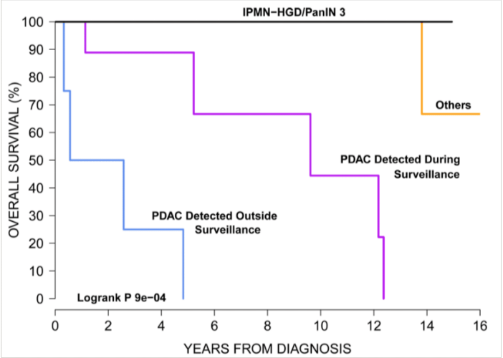
Why is early detection so important?
About 80% of cases are diagnosed stage III or IV
Non-specific or vague symptoms
Notes:
CAPS data re: stage I survival

Slide 13
What is involved in the study?
Permission to access medical records
Annual blood draw (must be completed at the participating center)
  Some groups may have a blood draw every 6 months
May be asked to answer questionnaires

Slide 14
Publications to date

Slide 15
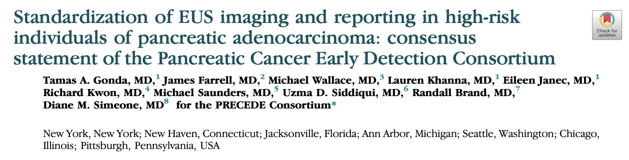
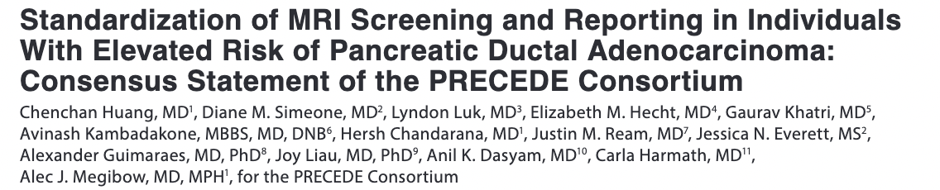
Notes:
Variability exists when reporting findings from screening
Proposed standard reporting and universal terminology
Goals
Improve consistency in reporting findings
Help facilitate research and clinical trial design, allowing for comparison between centers

Slide 16
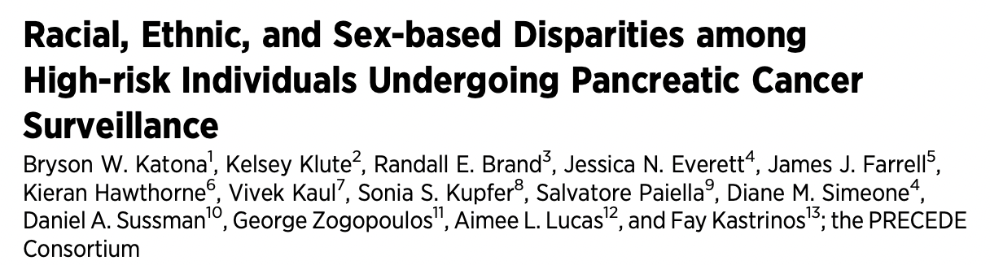
Study of 1,100+ people in cohort 1
66% female
87.7% Non-Hispanic White
  Only 2.9% Hispanic
Goal: decrease disparities in enrollment over the next 3 years

Slide 17
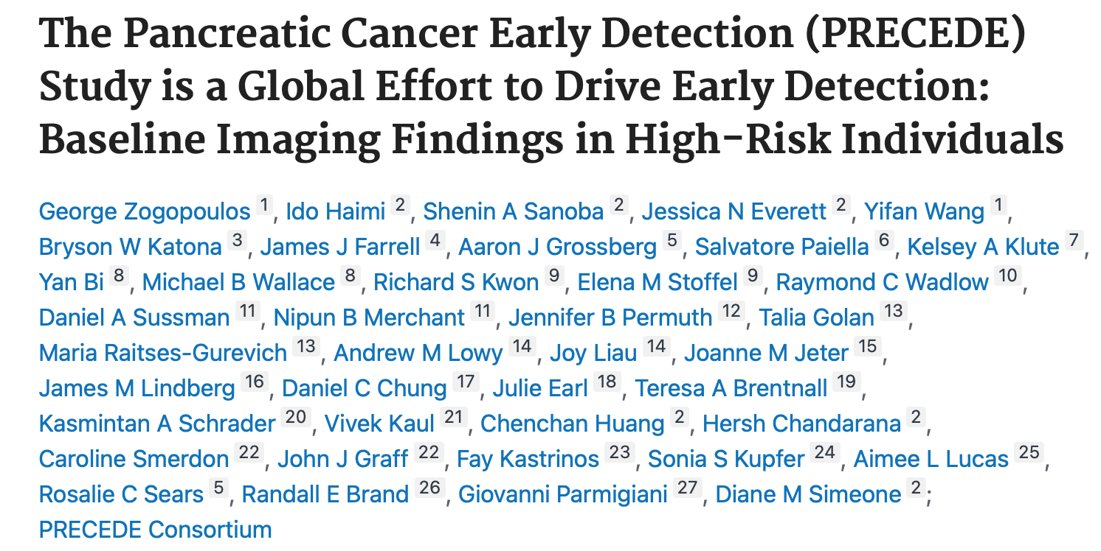
1,759 participants
No imaging
359 (20.4%)
MRI/MRCP
936
(53.2%)
EUS
464
(26.4%)
35% had 1 or more cysts (most in group with multiple affected family members without a mutation)
23 people had a solid lesion
  1 person had pancreatic cancer
  10 were pancreatic neuroendocrine tumors
Normal Pancreas 875 (62.5%)
Abnormality
525
(37.5%)
Notes:
Adult patients (N=3402) enrolled from 4/1/20 to 11/21/22 based on FMH and germline mutation status
1759 patients in Cohort 1 (highest-risk)
Familial pancreatic cancer (FPC) (n=670)
Pathogenic variant and FPC (n=115)
Pathogenic variant without FPC (n=615)
35% with pancreatic cysts
Increased age (OR, 1.06; p<0.001) and FPC (OR, 1.55; p<0.010) independently predictive
of pancreatic cyst, after multivariable analyssi

Slide 18

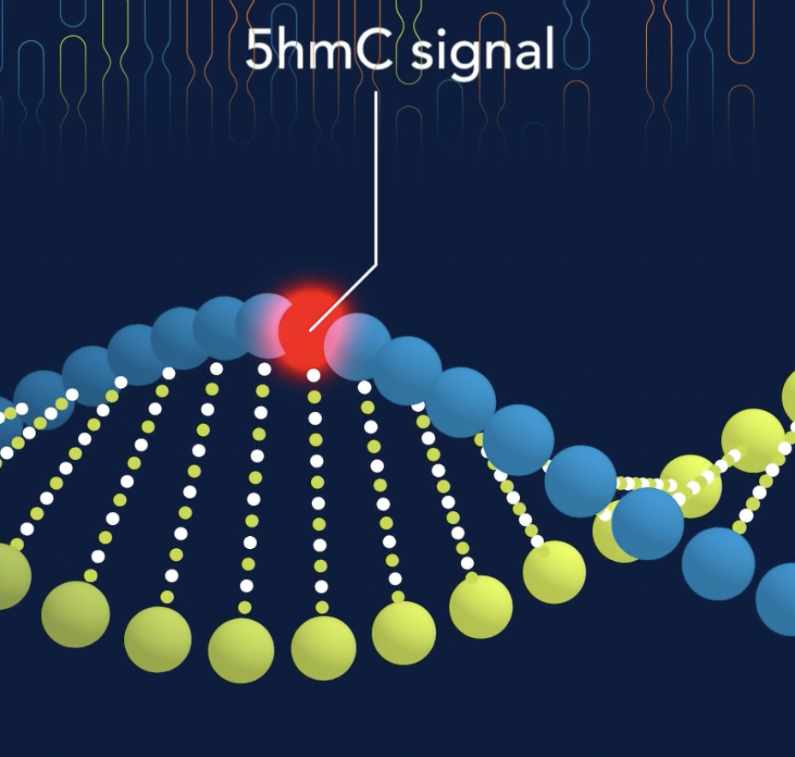

Updates from 2024 annual meeting
Promise with blood-based biomarkers for early detection
  Immunovia- top test models show 85% sensitivity and 98% specificity
  ClearNote Avantect -novel 5hm epigenomics approach using hydroxymethylation
    30% relative increase in detection of early stage over Ca 19-9
Technological advances
  PacBio next-generation short-read sequencing
    Greater accuracy and sensitivity for liquid biopsy
    Applications for earlier detection, improved treatment selection, improving monitoring for cancer recurrence

Slide 19
Future directions
Clinical validation of new genetic testing and biomarker technologies
Exploration of microbubble ultrasound imaging
(upcoming) Pilot study to examine modifiable risk factors (e.g., smoking, obesity) burden among BRCA1/2 carriers
Notes:
Immunovia clinical validation of n=1000 case control to be completed Q42024 (Dec)
Use of microbubbles using different contrast agents to enhance imaging signal

Slide 20

How can you sign up?
Visit www.precedestudy.org

Slide 21
Questions?
Pancreatologist: Bradford Chong, MD bradford.chong@bsd.uchicago.edu
Genetic Counselor: Christine Drogan, MS, CGC cdrogan@bsd.uchicago.edu
Study Coordinator: Nia Howard, BS
Nia.howard@bsd.uchicago.edu

